Slide 1

Project:
Iron Regression
House Sale Prices
for King County
Negar Mokhtari

Slide 2



Project Overview:
Data Source:
House Sale data for King County from May 2014 to May 2015.
Dataset size: (rows: 21,613 & columns: 21)
All features types are numeric
Dataset is clean and there not any null value or duplicated
TARGET --> Price
EDA & Data Processing
04
Project Goal
Features most significally impact the house price.
Best model to predict the house prices.

Slide 3
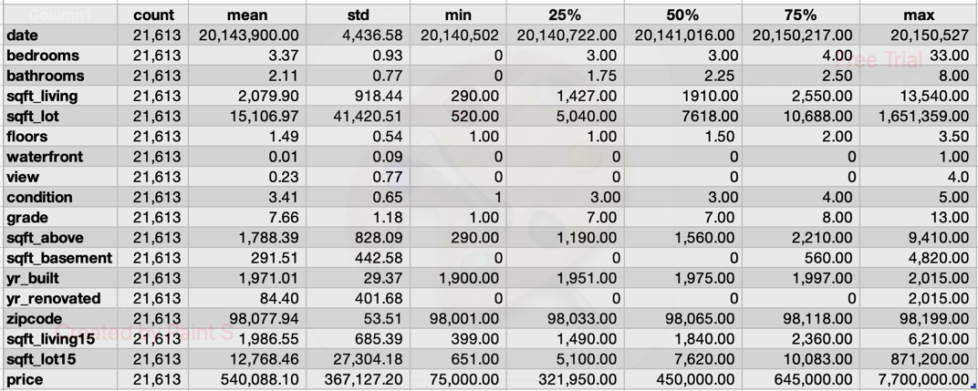
EDA- Descriptive Statistics:

Slide 4
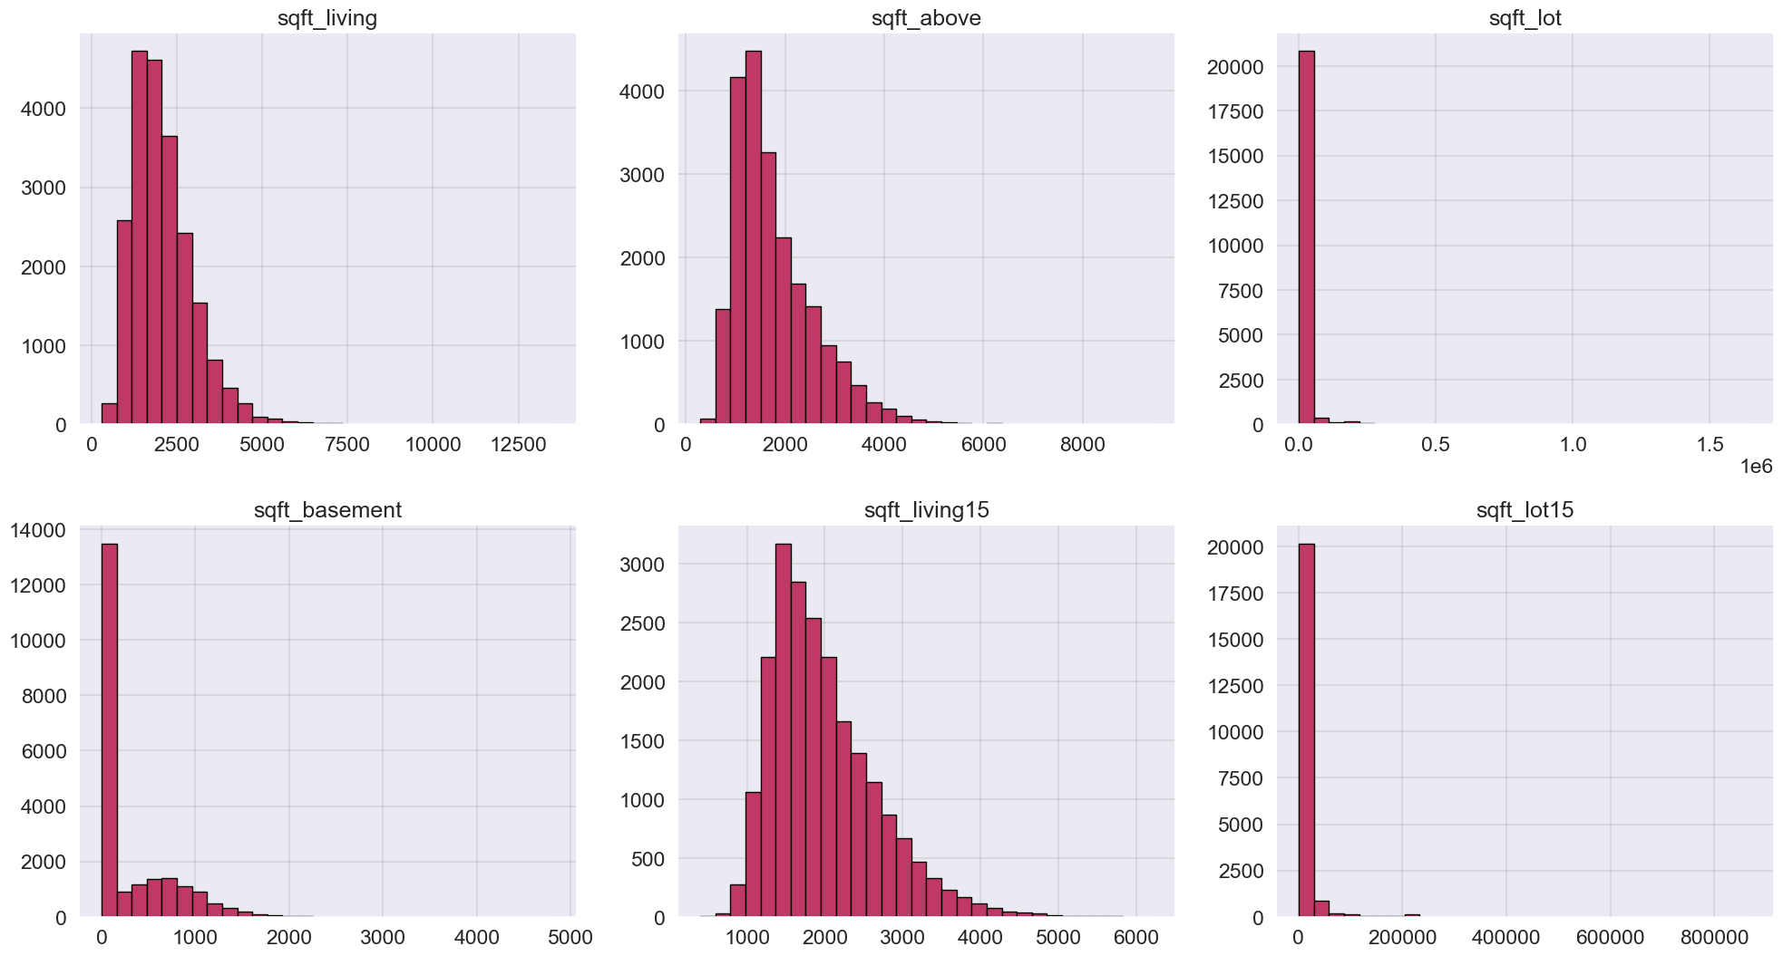
EDA- SQFT Distribution:

Slide 5
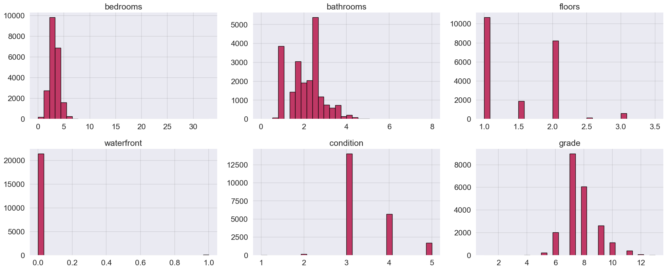
EDA- Other Feature Distribution:

Slide 6
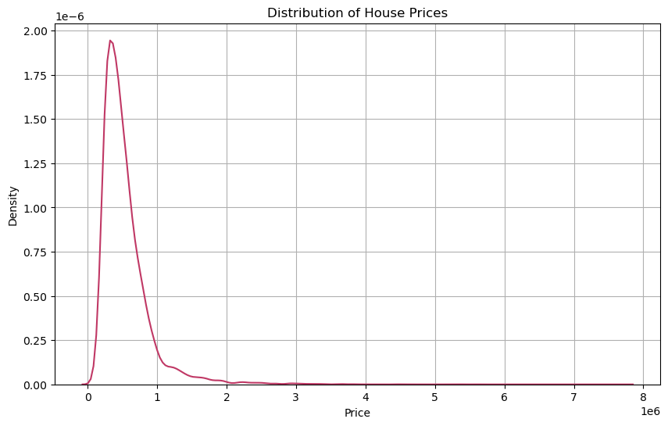
EDA-Price Distrubution:
Target > Price Plot

Slide 7
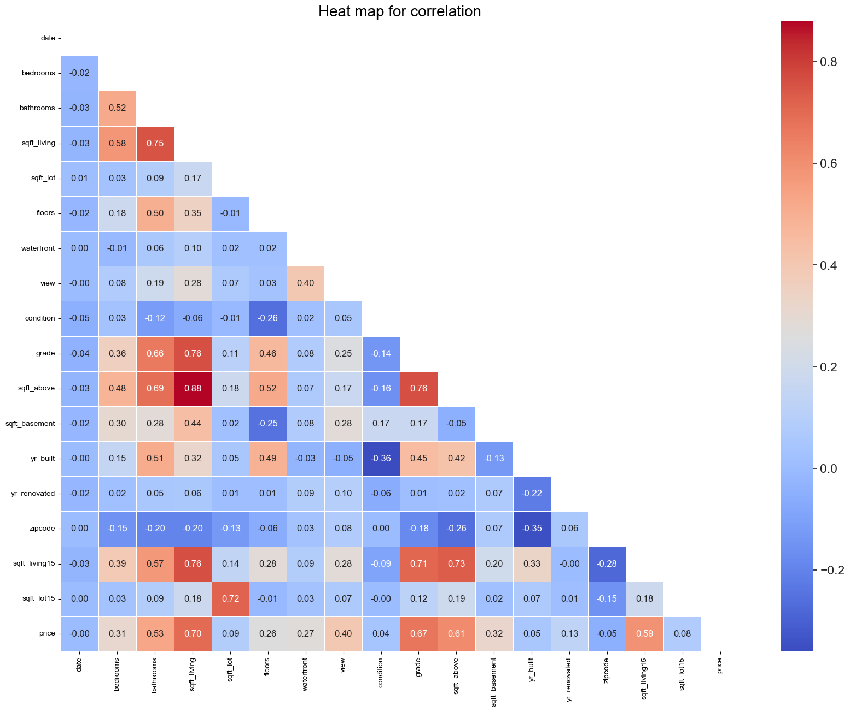
EDA- Correlation Matrix:

Slide 8
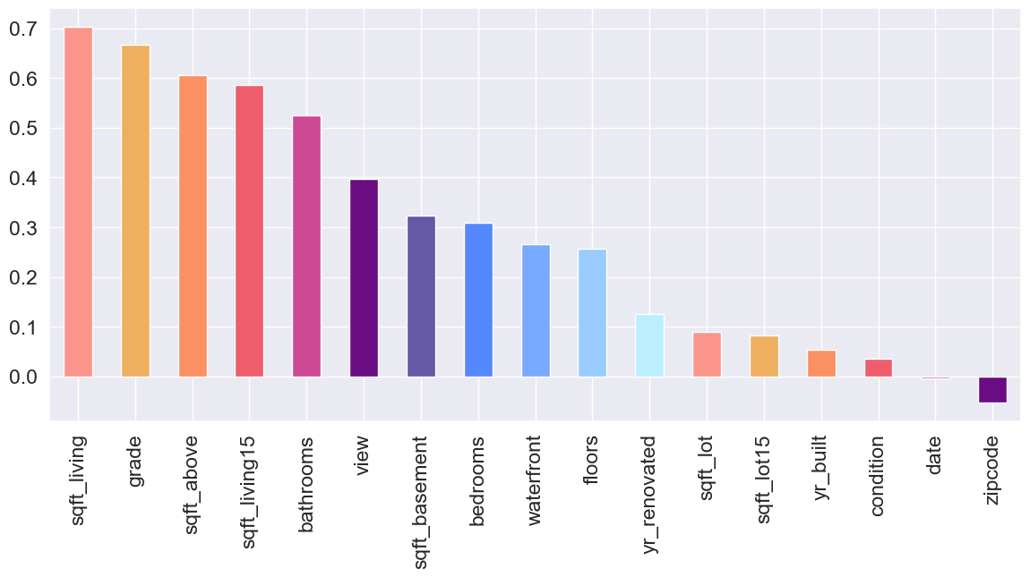
EDA- Correlation with Price
Features most significally impact the house price

Slide 9
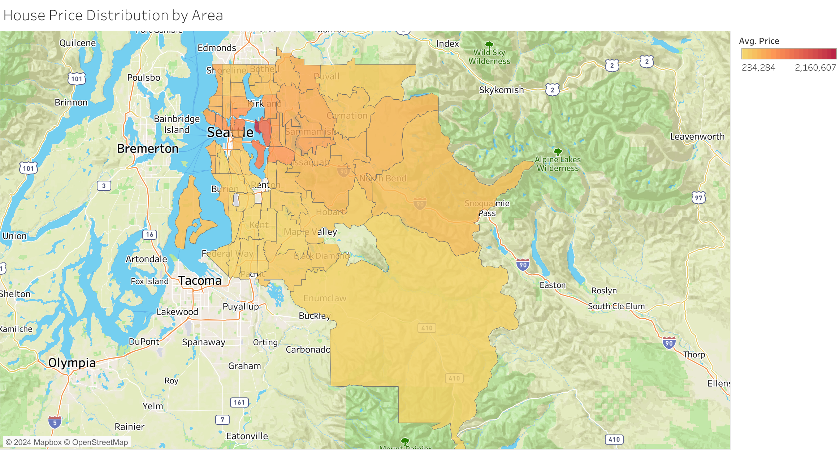
Zipcode Distrubition
Tableau link
Top 10 highest Price Area
zipcode | Ave. price
98039 | 2,160,607
98004 | 1,355,927
98040 | 1,194,230
98112 | 1,095,499
98102 | 901,258
98109 | 879,624
98105 | 862,825
98006 | 859,685
98119 | 849,448
98005 | 810,165

Slide 10
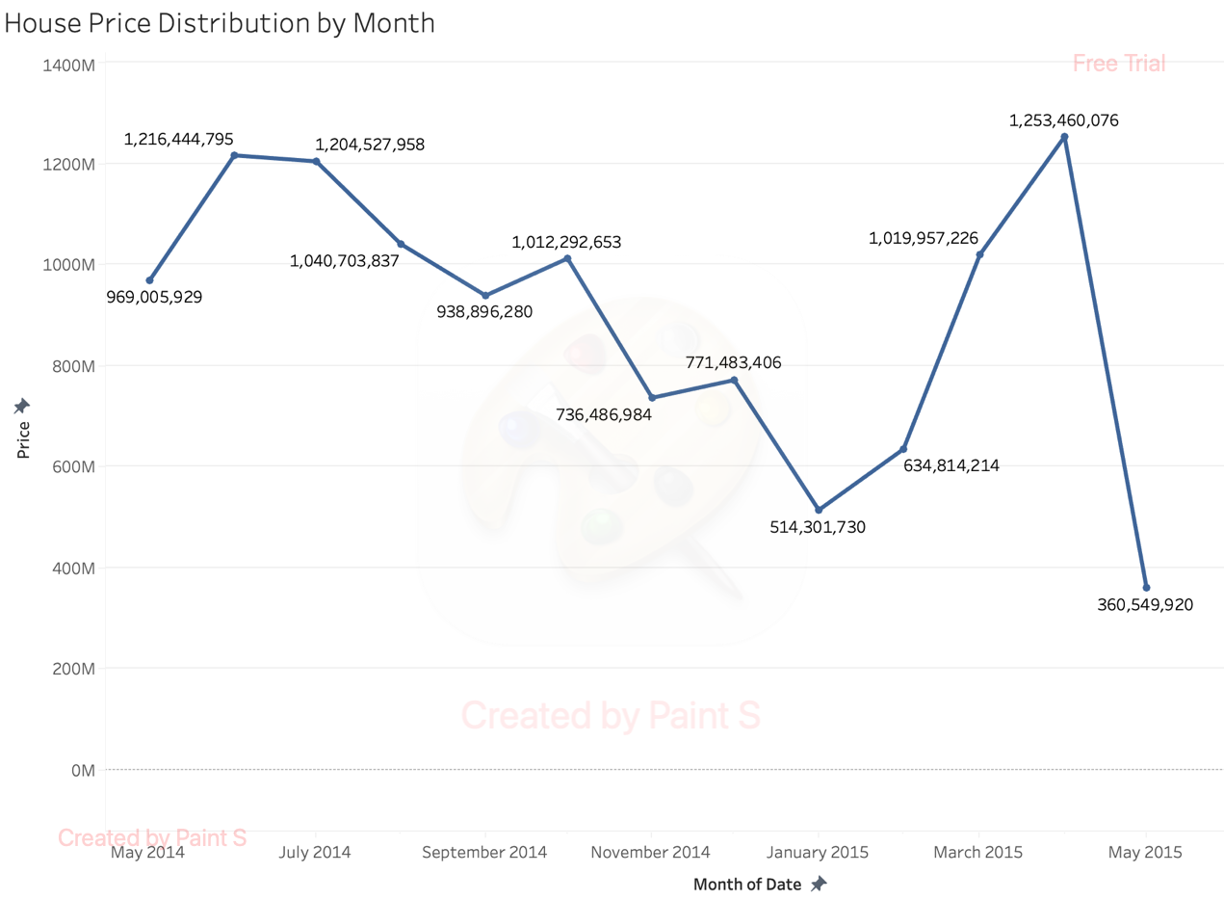
Total Sale Price across Time:
Tableau link

Slide 11

Machine Learning Models for
Predicting House Prices

Slide 12
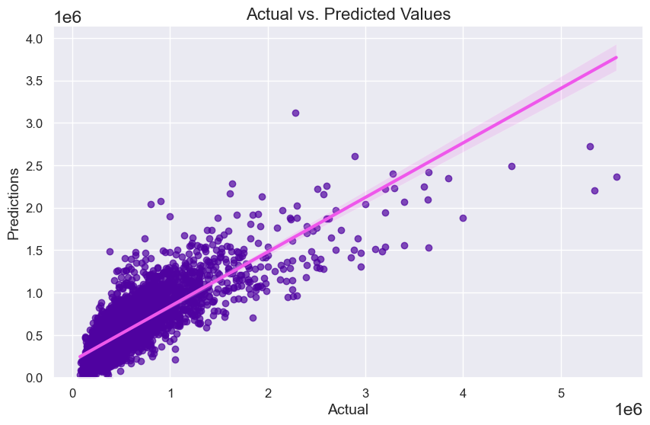
Model: Linear Regression
Train-Test Split
100% of data: 21613
70% for train: 15129
30% for test: 6484
Metrics:
R2 = 0.6528
RMSE = 223893.926
MSE = 50128490100.9413
MAE = 142887.1473

Slide 13
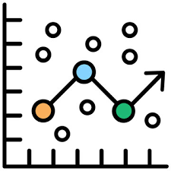
Comparison of Models:
MODELS | R² | RMSE | MSE | MAE
Linear Regression | 0.65349 | 223,660.35 | 50,023,950,000 | 142,996.92
Ridge | 0.65343 | 223,682.27 | 50,033,760,000 | 143,003.92
Lasso | 0.65349 | 223,661.05 | 50,024,270,000 | 142,997.16
Decision Tree | 0.60732 | 238,096.90 | 56,690,130,000 | 127,661.79
KNN | 0.48144 | 273,611.08 | 74,863,020,000 | 165,269.84
XGBoost | 0.67775 | 215,690.53 | 46,522,400,000 | 130,857.90

Slide 14
Improving Model (XGB)
Standardization (StandardScaler)
After Standardization:
R2 = 0.8274
RMSE = 157867.1724
MSE = 24,922,044,121.1908
MAE = 79,850.365
Before Standization:
R2 = 0.6777
RMSE = 215,690.5253
MSE = 46,522,402,684.4673
MAE = 130,857.8979

Slide 15
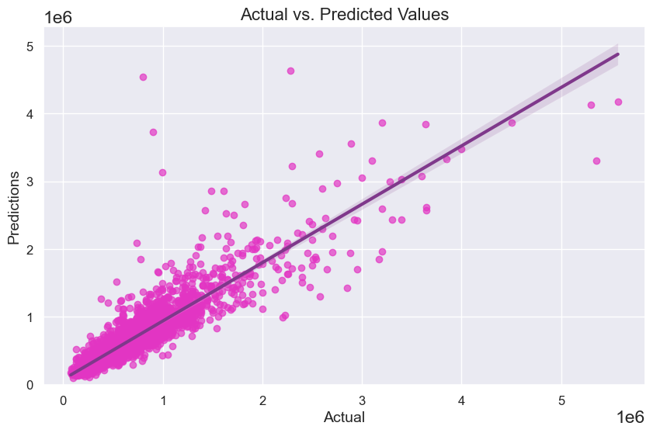
Scatter Plot for Actual and Predicted Price
After Standardization

Slide 16

Dealing with Outliers:

Slide 17
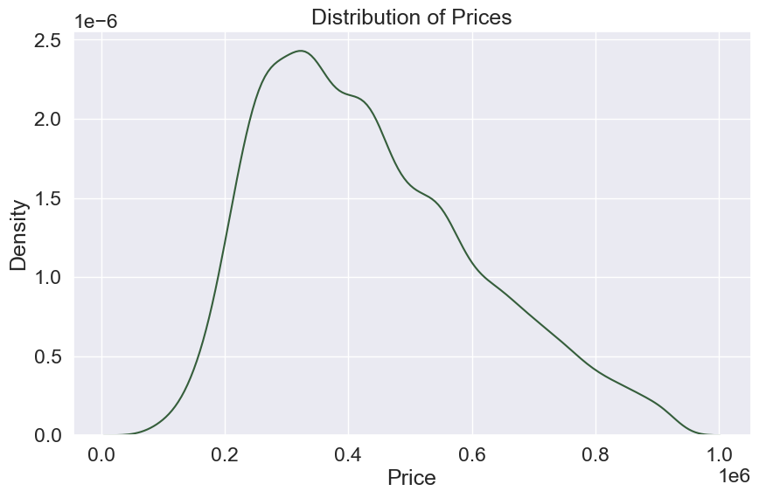
Price Distribution
Agter removing outliers

Slide 18
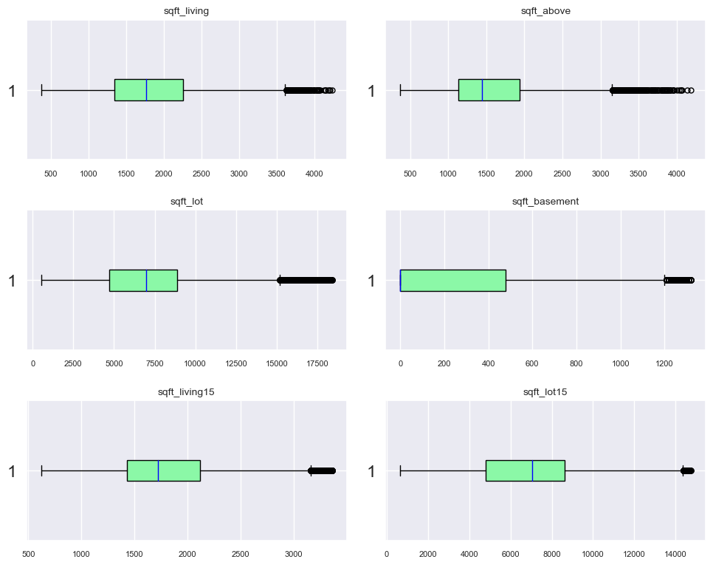
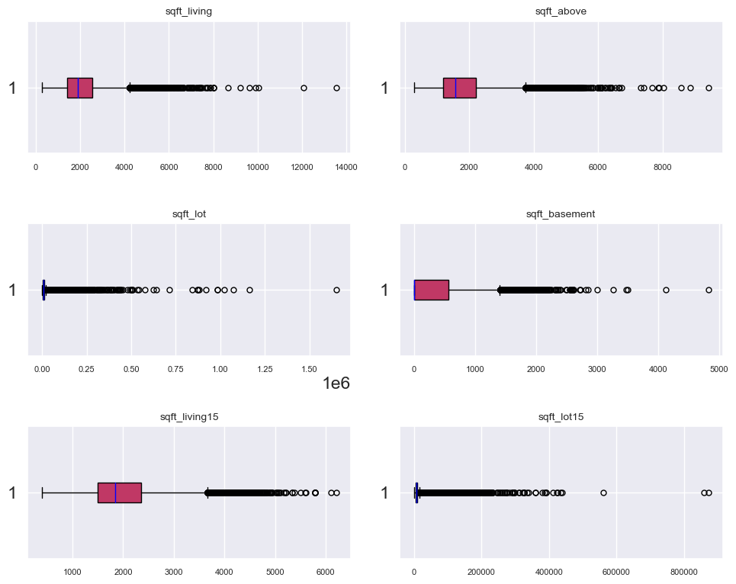
SQFT:
AFTER removing outliers
BEFOR removing outliers

Slide 19
SQFT:
AFTER removing outliers
BEFOR removing outliers

Slide 20
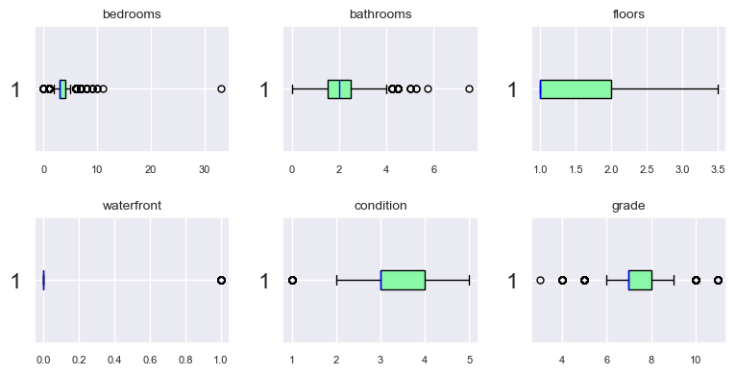
Other features same as before

Slide 21
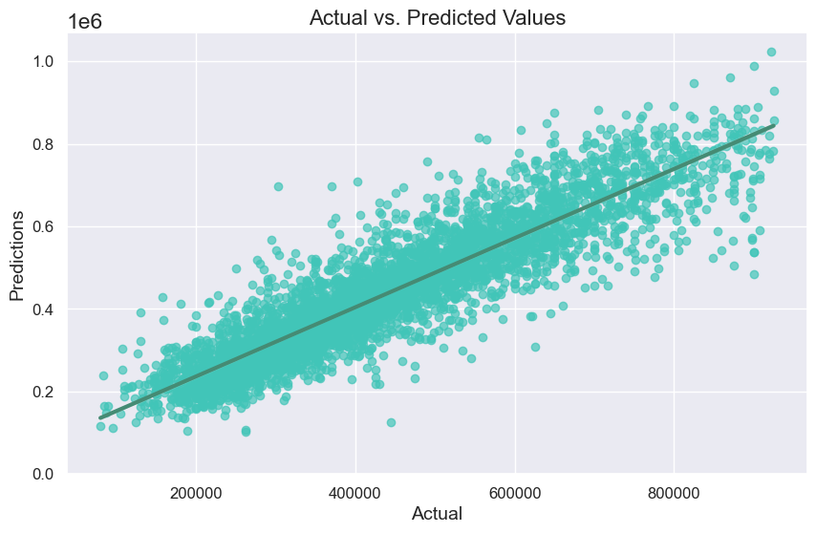
Scatter Plot for Actual and Predicted Price
After removing outliers
Model: XGBoost
R2=: 0.8298
RMSE = 71,068.4148
MSE = 5,050,719,586
MAE = 51,101.5363

Slide 22
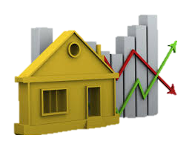
Thanks For Your Attention

